Slide 1
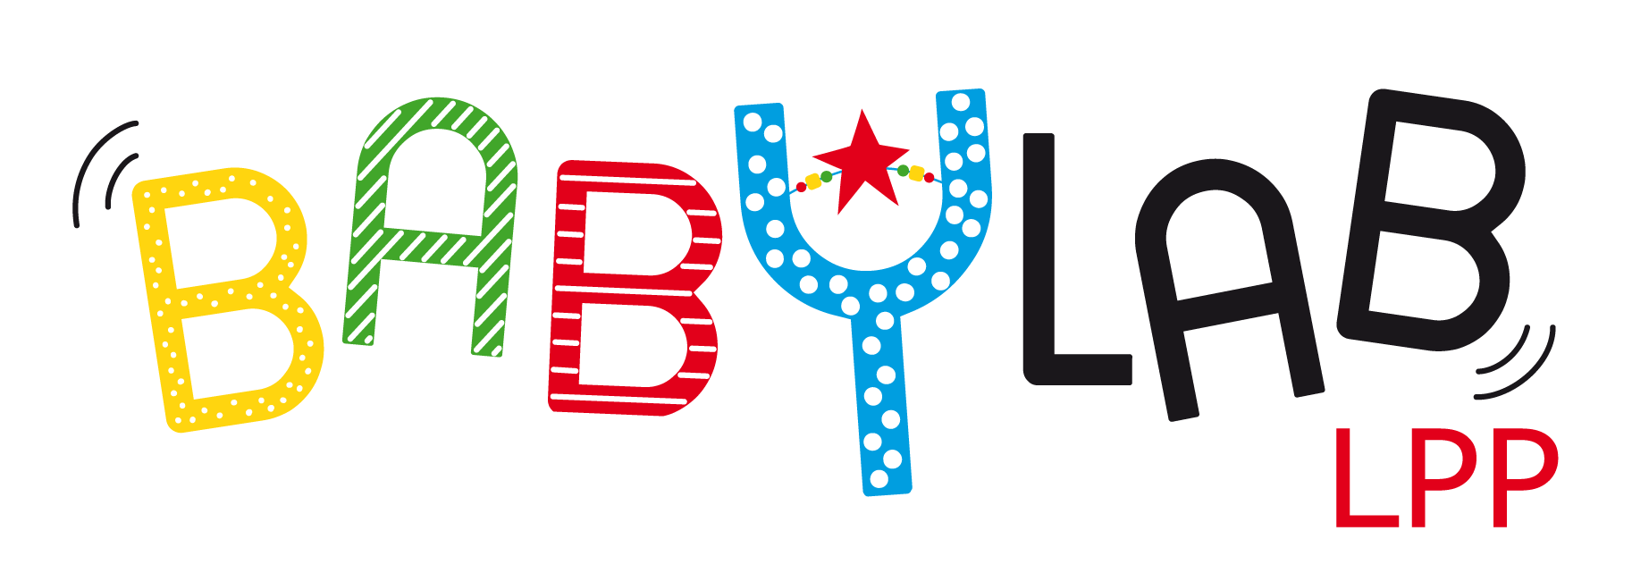





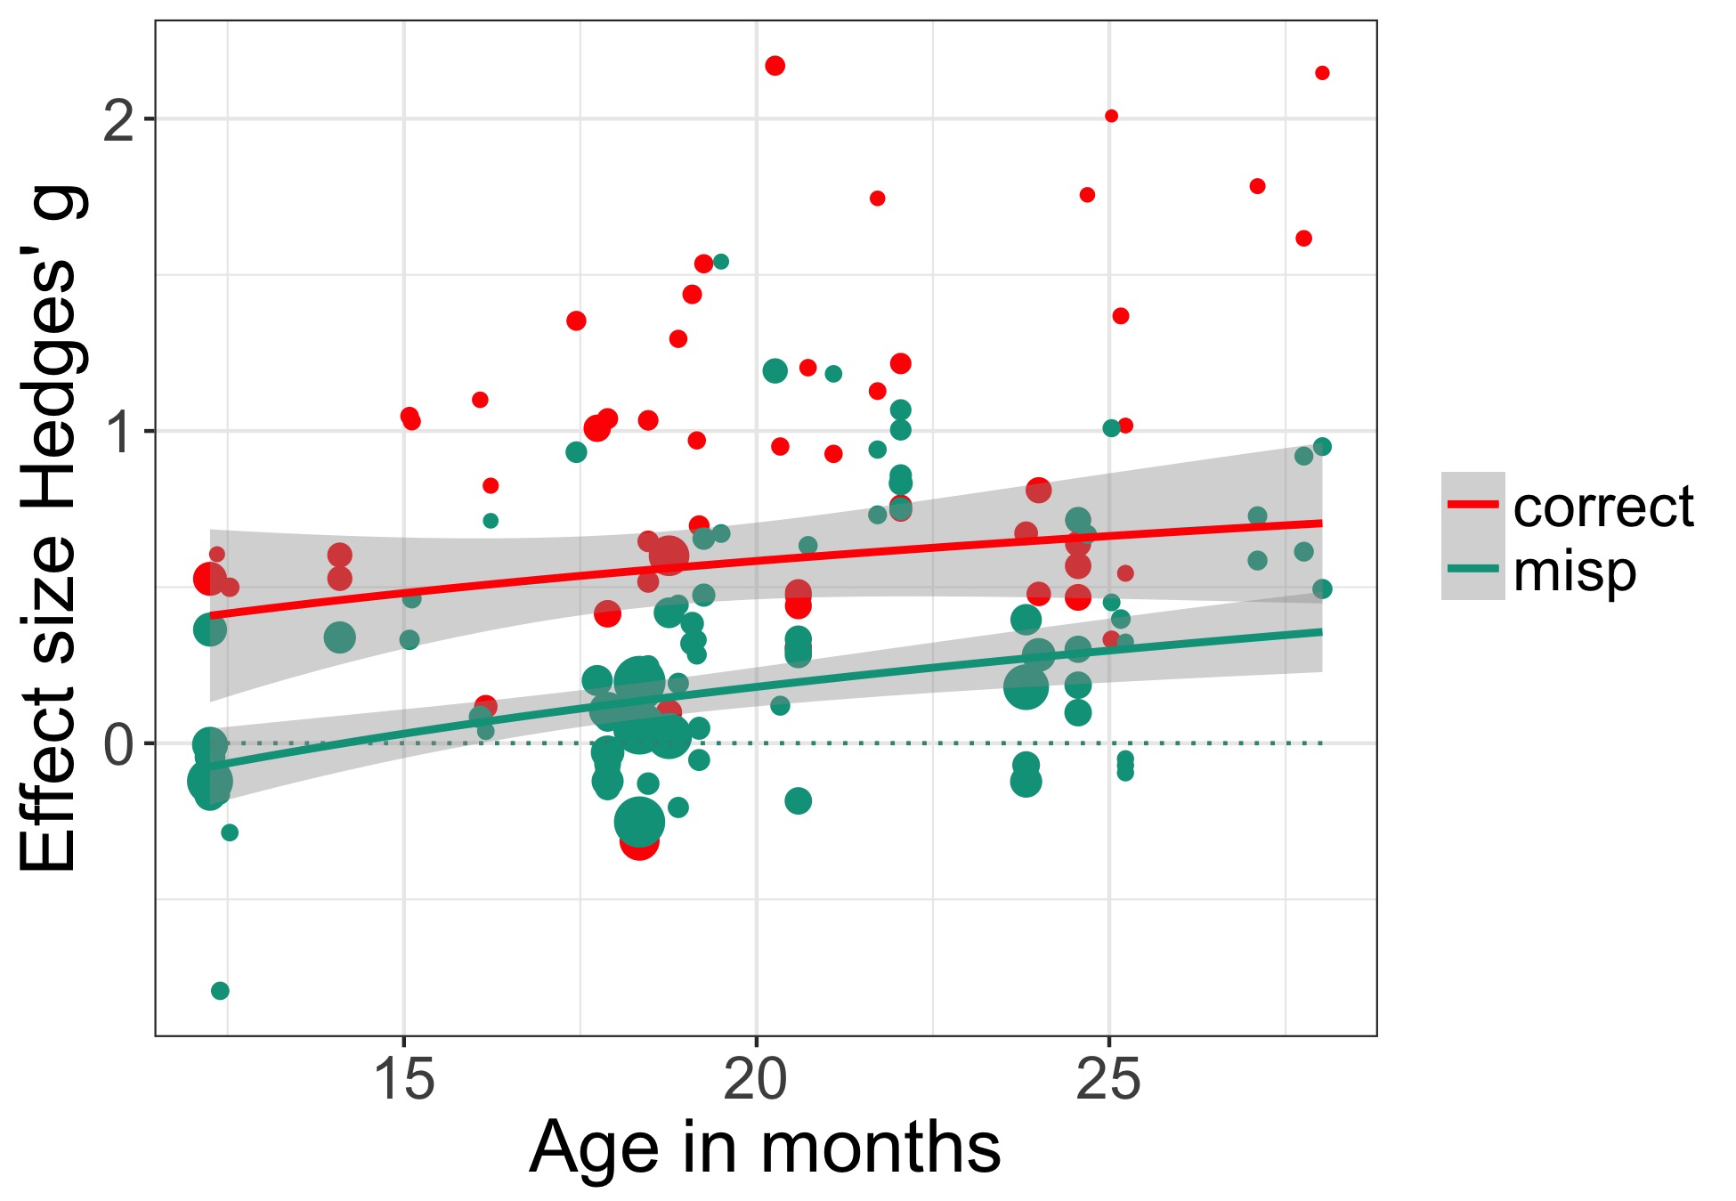

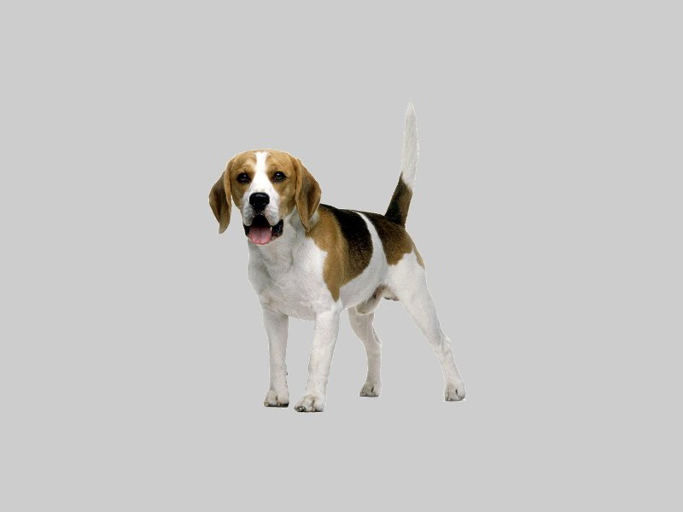
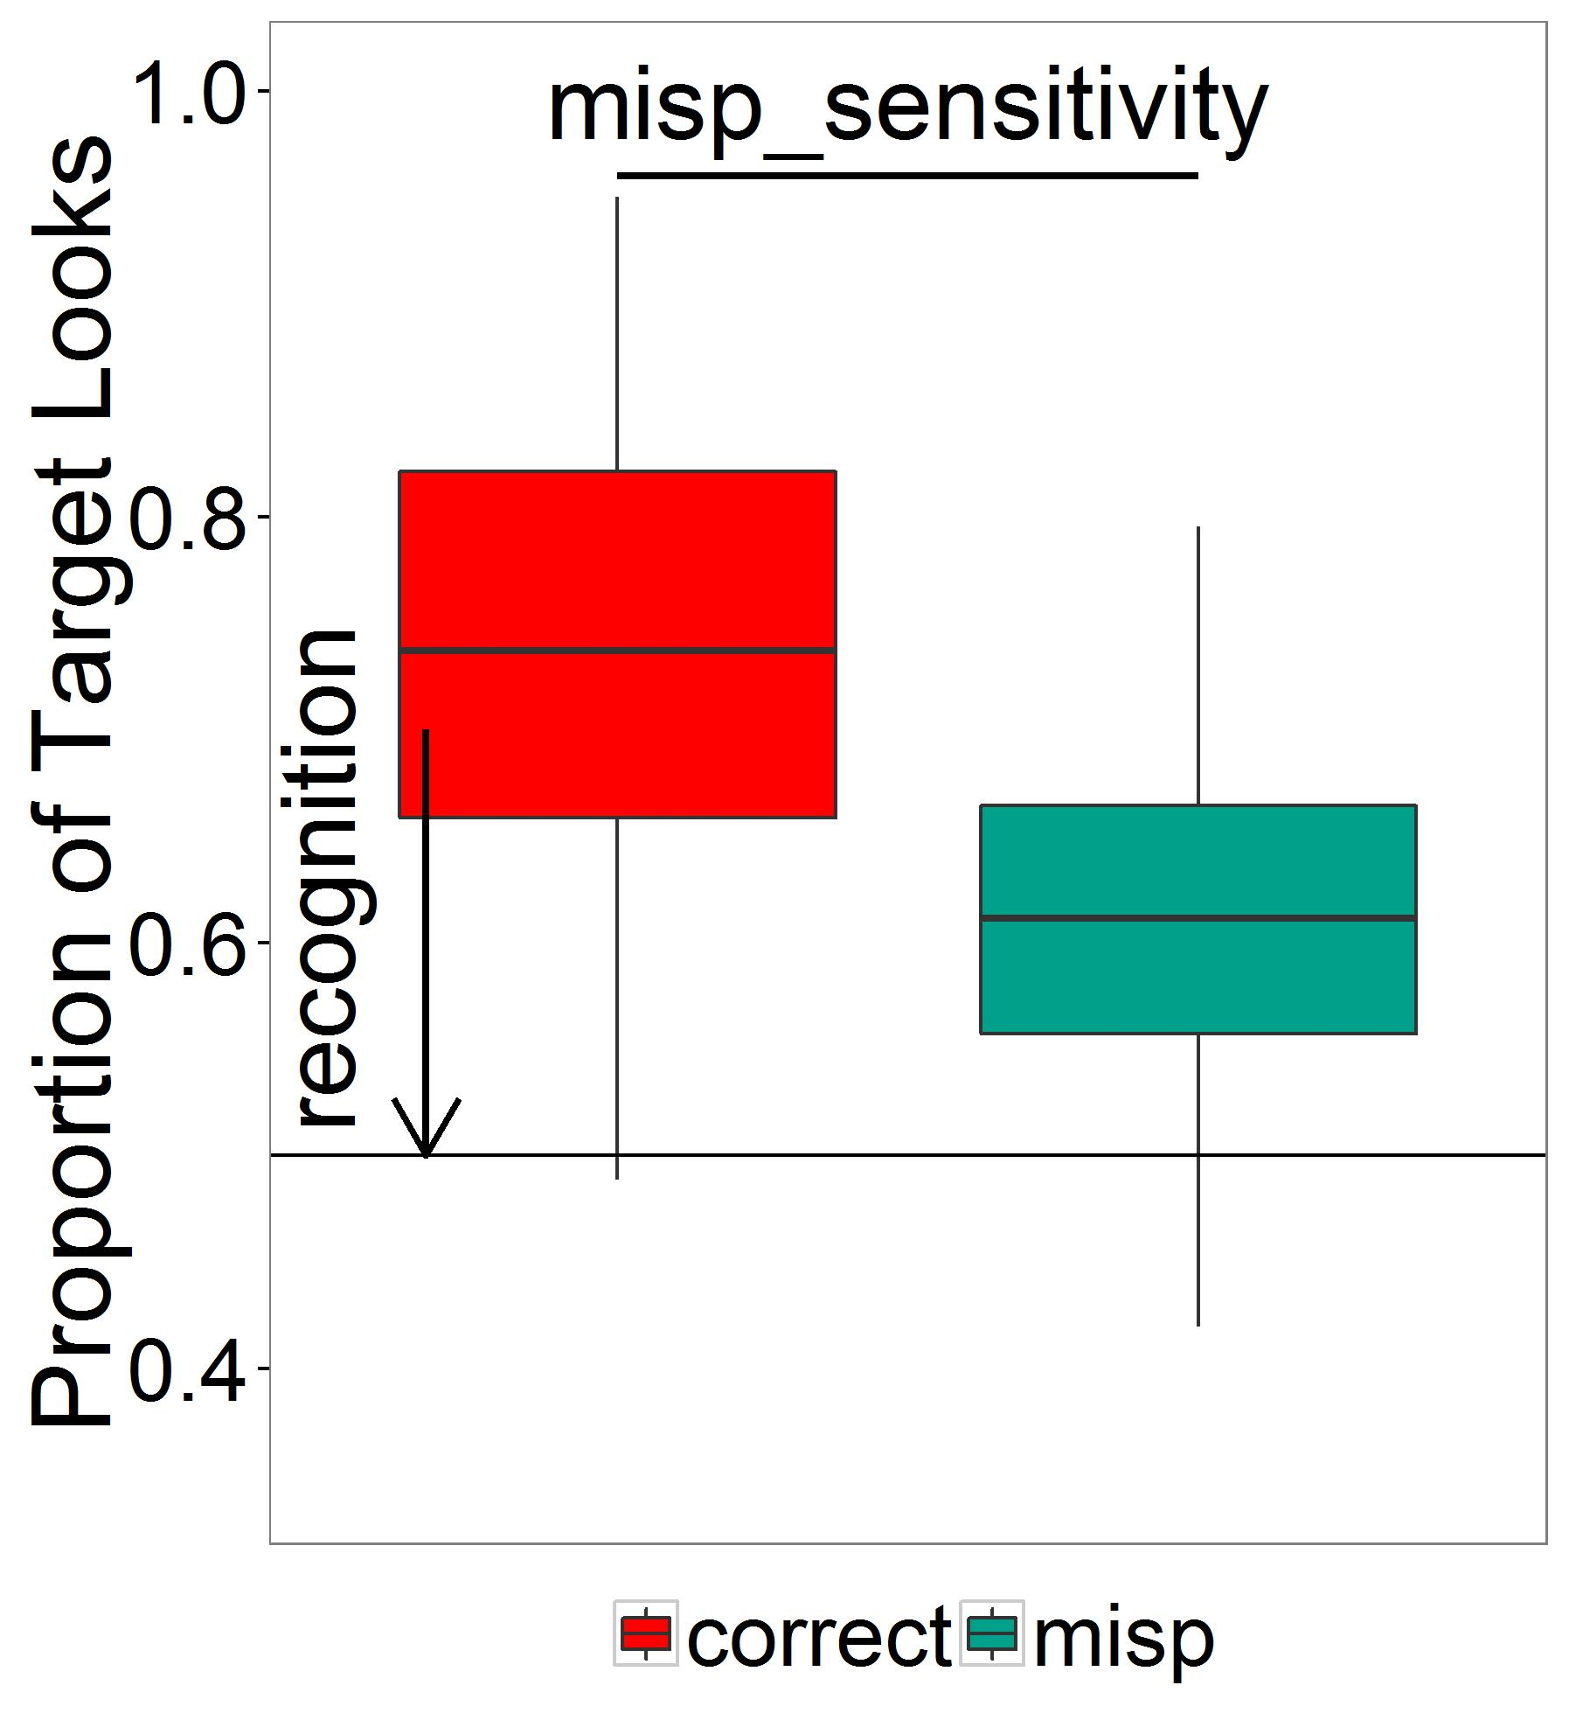

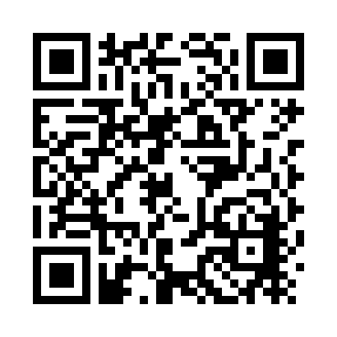
Babies know words, even when they are mispronounced: A meta-analytic view
Katie Von Holzen¹ & Christina Bergmann²
1. Université Paris Rene Descartes, Laboratoire de Psychologie de la Perception CNRS, France
2. LSCP, Département d'Etudes Cognitives, ENS, EHESS, CNRS, PSL Research University
Mispronunciation Sensitivity
Infants’ sensitivity to changes in the phonological form of familiar words
Dog
Tog
Research Question
How does mispronunciation sensitivity change as infants develop?
More sensitive with development¹
Less sensitive with development²
Sensitivity does not change with development
Correct
Recognition: g = 0.88, SE = 0.12, p < .001
No interaction with age
Mispronunciation
Recognition: g = 0.34, SE = 0.07, p < .001
Age: g = 0.04, SE = 0.01, p = .001
Correct vs. Mispronunciation
Sensitivity: g = .47, SE = 04, p < .0001
No interaction with age
As infants age, more target looking in mispronounced trials (Theory 2)
Sensitivity to mispronunciations stays consistent as infants age (Theory 3)
Participants | Stimuli | Procedure | Results
Age in days | # features | # trials | DV type
Sample size (n) | Change position | Distractor familiarity | vocabulary
Native Language | Consonant vs. vowel | Distractor overlap | misp sensitivity
Database Information
25 papers (mostly journal articles)
190 unique experimental conditions
1001 infants
12 to 28 months
What’s in your File Drawer?
Do you have a mispronunciation study that is unpublished?
Contact us and add it to the meta-analysis!
References
Werker, J. F., & Curtin, S. (2005). PRIMIR: A Developmental Framework of Infant Speech Processing. Language Learning and Development, 1(2), 197–234
Best, C. T. (1994). The emergence of native-language phonological influences in infants: A perceptual assimilation model. Haskins Laboratories Status Report on Speech Research
Contact: Katie Von Holzen (katie.m.vonholzen@gmail.com) & Christina Bergmann (chbergma@gmail.com)

